Slide 1
Index
What is an IDE
Projects
Build and Deploy
Debugging
Code analysis, suggestions
Code completion
Code navigation
VCS integration

Slide 2
What is an IDE
IDE stands for Integrated Development Environment
It’s an environment providing a collection of tools aiding developers to:
Manage different projects (projects, solutions)
Understand existing code more easily (Code navigation, usages, refactoring)
Work more efficiently (code completion, debugging, etc…)
Collaborate effectively with others (VCS, issue tracker integration)
Test code and write tests (Unit test, code coverage, Profiling)

Slide 3
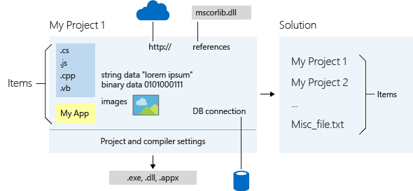
Manage Projects
Manage projects in Visual Studio
Solution: is a collection of projects, files and associated settings
Project: is a collection of files, data, dependencies and settings

Slide 4
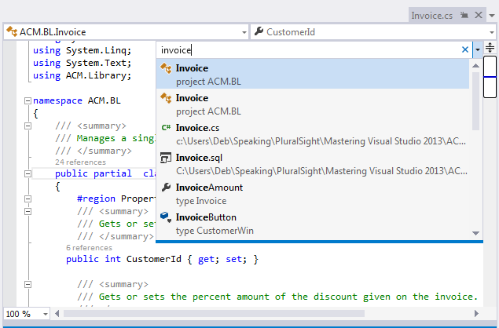
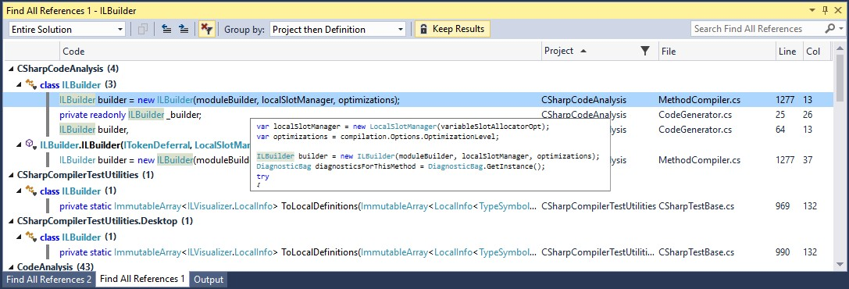
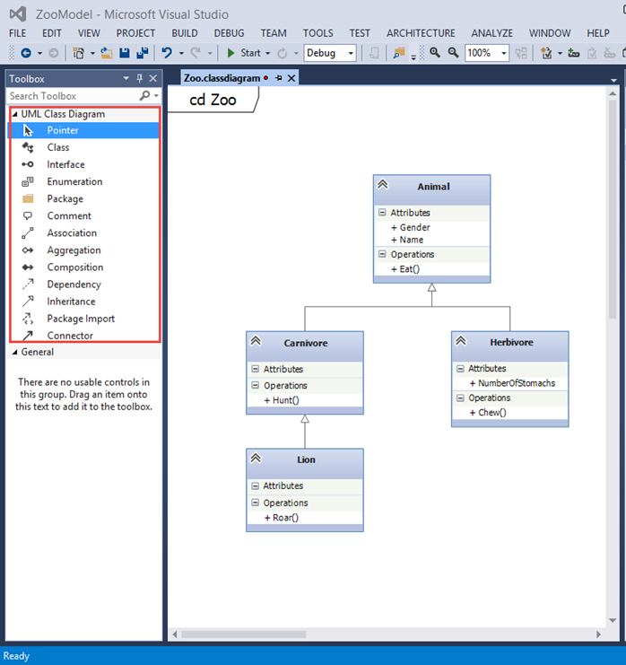
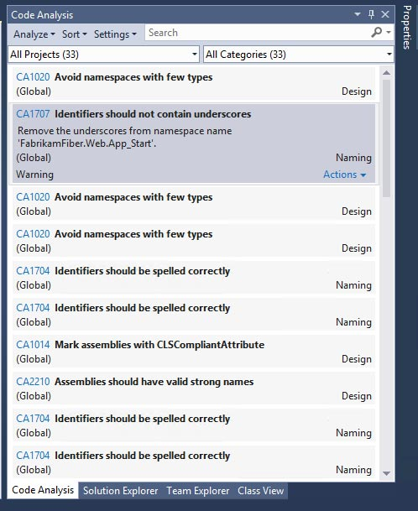
Understand Code
Navigate code:
Find classes quickly
Go to definition
Find all references
Analyze code:
Static Code Analysis
UML diagrams

Slide 5
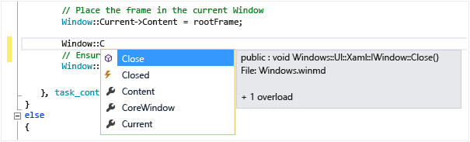
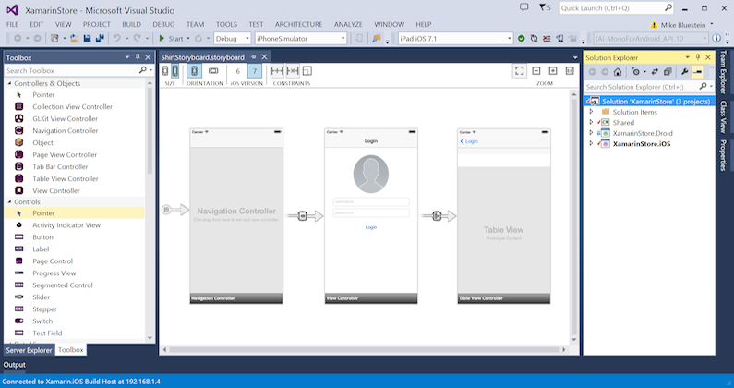
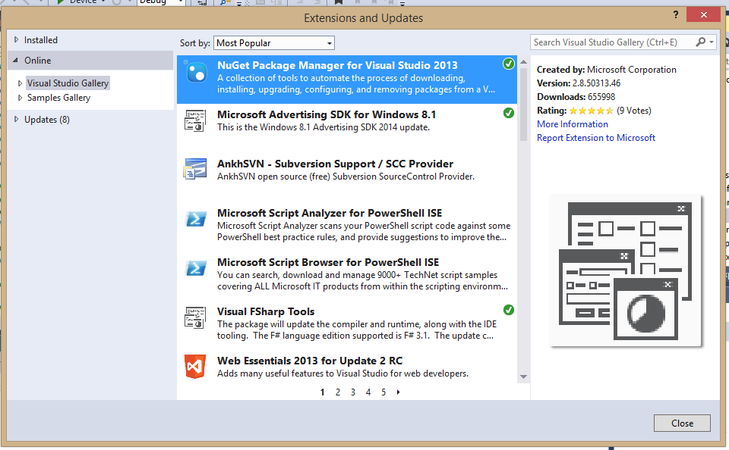
Work efficiently
Code aid:
Code completion
Debugging
Intellitrace
Exception handling
Visual interface and DB design
Plugins (nuget)

Slide 6
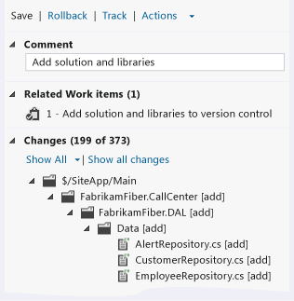
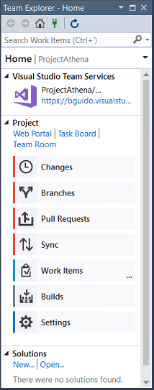
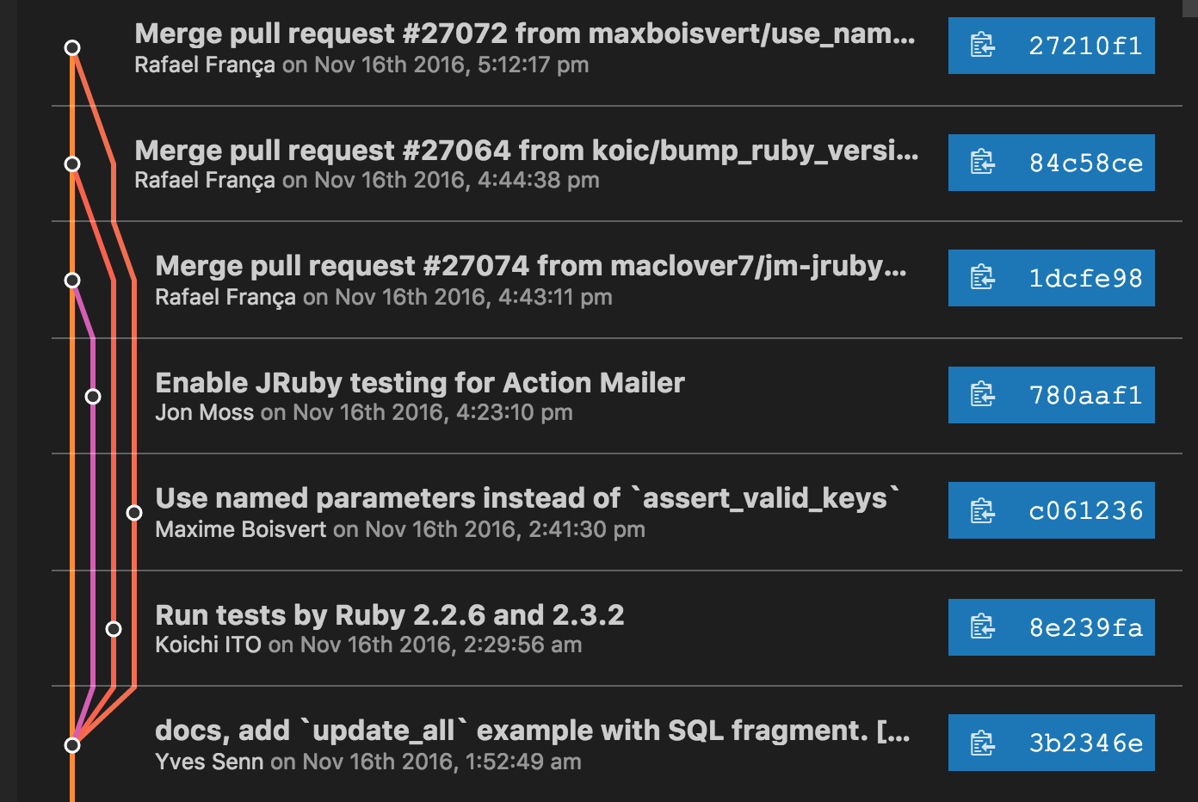
Collaborate
VCS integration (TFS, Git, etc…)
Look at current and past changes
Sync working copy without leaving the IDE
Work items integration
Query your WI from the IDE
Associate changes to WI
CI/Build integration
Monitor build status
Schedule new builds

Slide 7
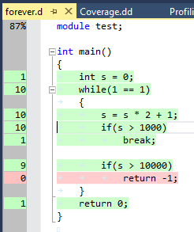
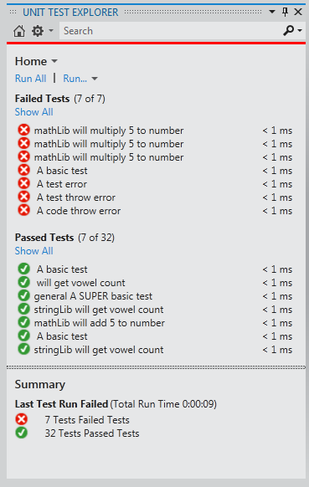
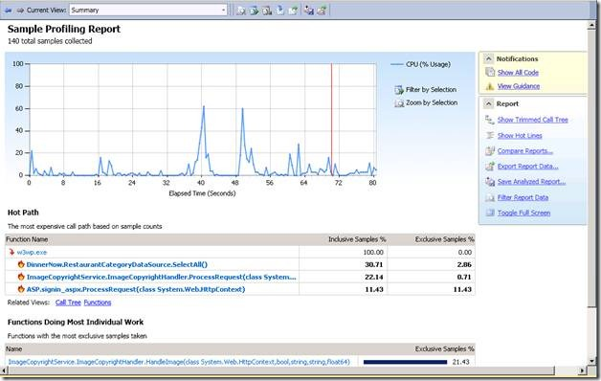
Test
Test and profile code:
Unit test integration
Code Coverage
Profiler

